Slide 1
Quality of End-of-Life Cancer Care
IST 687 Project
Catherine Devine, Yodit Ayalew, Lauren Foltz, Jack Harris

Slide 2
Background on Data Set
Data source: Dartmouth Institute
Dartmouth Atlas Project (DAP) cancer events
https://data.world/dartmouthatlas/cancer-patients-death
Data from 938 hospitals including location of hospital (city & state) as well as 12 attributes surrounding treatment and outcomes at end of life for elderly cancer patients. The data spans 2003-2007.
Number of deaths among cancer patients assigned to hospital
Percent of cancer patients dying in hospital
Percent of cancer patients admitted to hospital during the last month of life
Number of hospital days per cancer patient during the last month of life
Percent of cancer patients admitted to ICU during the last month of life
Number of ICU days per cancer patient during the last month of life
Percent of cancer patients receiving life-sustaining treatment during the last month of life
Percent of cancer patients receiving chemotherapy during the last two weeks of life
Percent of cancer patients enrolled in hospice during the last month of life
Number of hospice days per cancer patient during the last month of life
Percent of cancer patients enrolled in hospice during the last three days of life
Percent of cancer patients seeing ten or more physicians during the last six months of life

Slide 3
Goals
Analyze data set to gain actionable insights that would be beneficial in the HealthCare industry (to Hospitals, Insurers, Doctors, Patients, and/or Family Members).
Look at
Differences in outcomes across geographies
Cancer death among hospitals
Hospital admissions during the last month of life
Intensive care admission trends on time
Chemotherapy during the last two weeks of life
Do descriptive statistics and histograms for attributes with distribution analysis of the charts
Show direct or inverse variations between attributes and compare the result with correlation between those attributes
Identify strong positive and weak negative correlations and try to interpret the results
Show linear regression for all models and see the trend for strongest negative and positive correlation from the regression

Slide 4
Analysis Outline
Data Cleansing
Descriptive Statistics & Histograms
Mean, Median, Standard Deviation, Skewness, and Kurtosis
Look at variables by Hospital
Look at variables by State
Visualize variables onto US Map
Run a correlation on all 12 variables
Run Linear Regression on selected variables

Slide 5
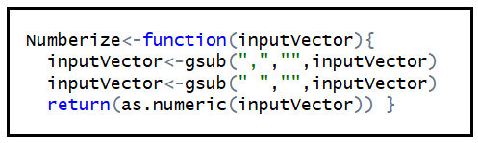
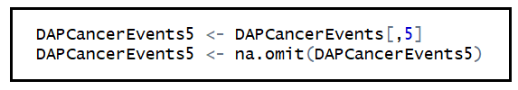
Data Cleansing
Remove unwanted rows/columns
Remove first row of NA data
Removed last row of aggregate data
Remove 22 columns containing confidence interval data
Column Names
Rename the remaining columns (giving simplified names)
Numberize
Use Numberize function to remove commas, spaces, and return data as numeric
How to deal with missing data?
Create subsets and utilize na.omit.

Slide 6
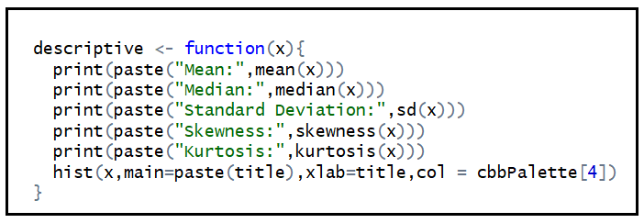
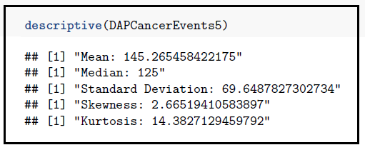
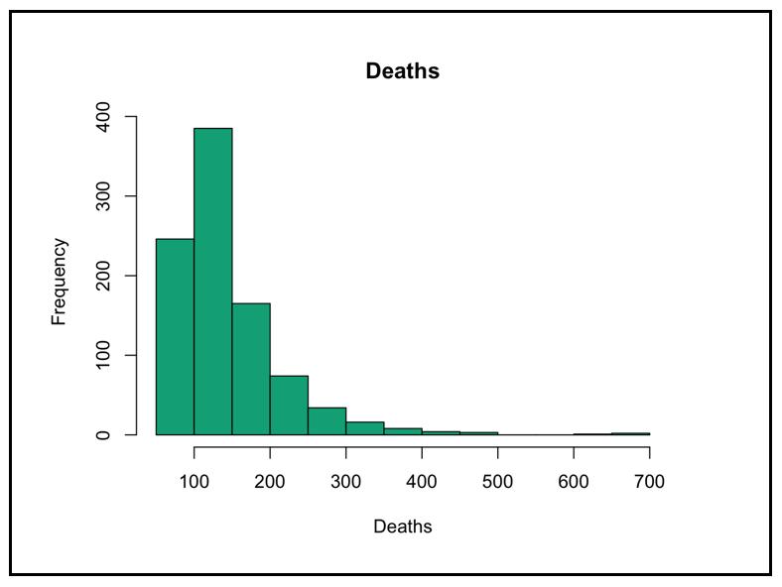
Descriptive Statistics & Histograms
Write a function for descriptive statistics & histograms
Apply to each of our 12 data subsets

Slide 7
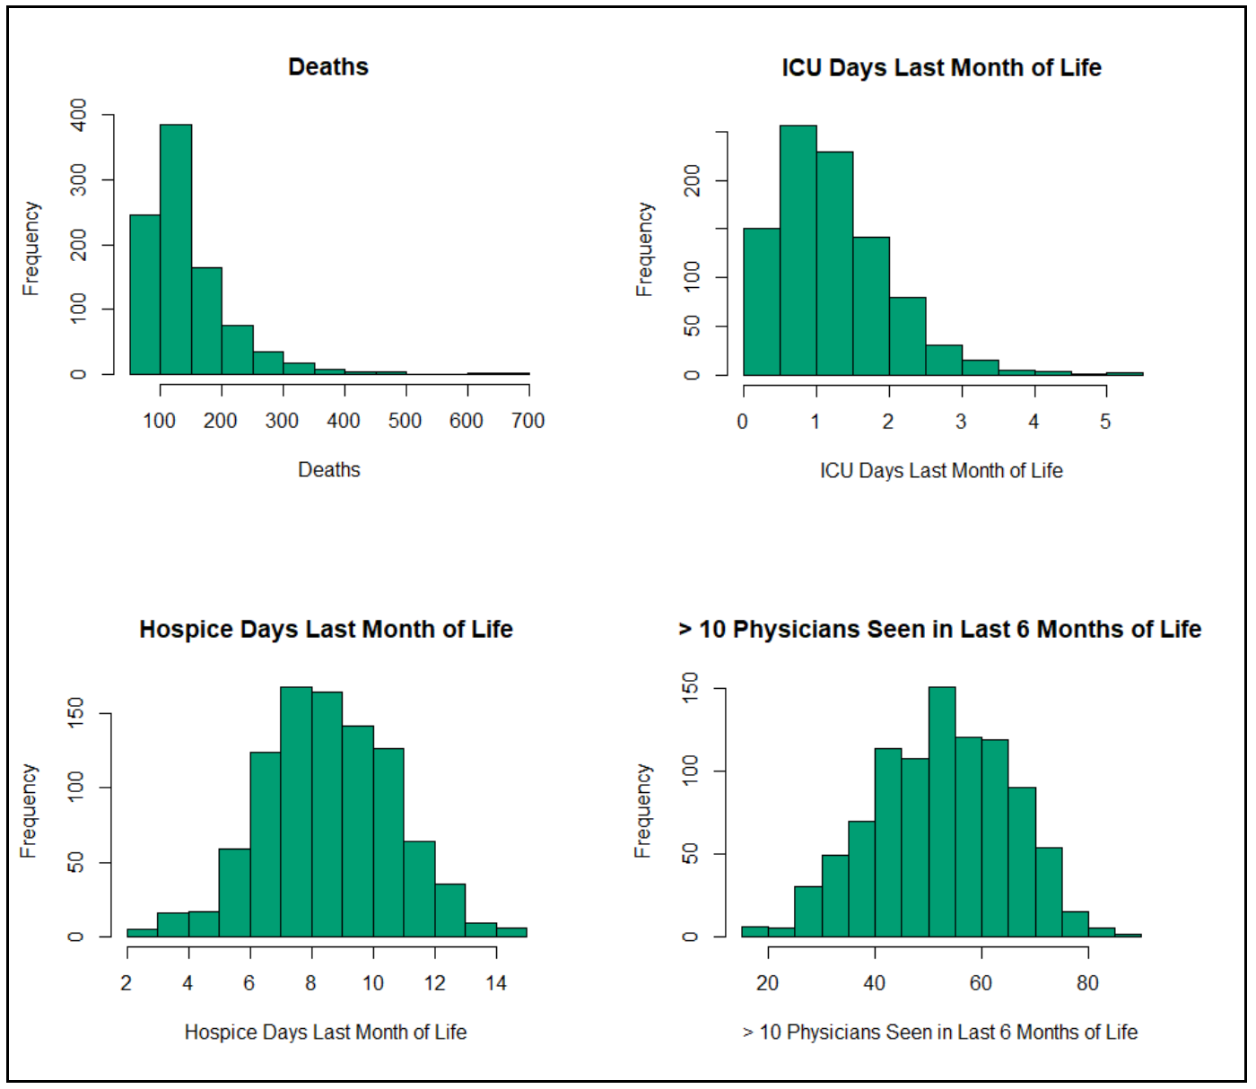
Descriptive Statistics & Histograms
Trends/Insights
Highest Mean, Median, Standard Deviation, Skew, and Kurtosis: Deaths (note: chart shows a long right tail)
Lowest Mean, Median, Standard Deviation: ICU days last month of Life (note: chart has a moderate right tail)
Lowest Skew: Hospice days last month of life (note: chart shows a normal distribution)
Lowest Kurtosis: % over 10 physicians seen in last 6 months (note: chart shows a normal distribution)

Slide 8
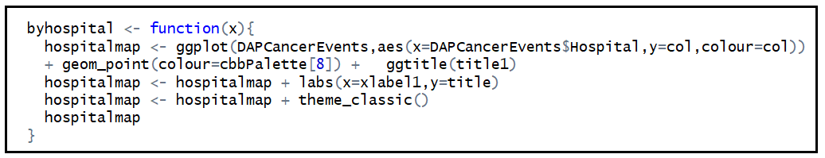
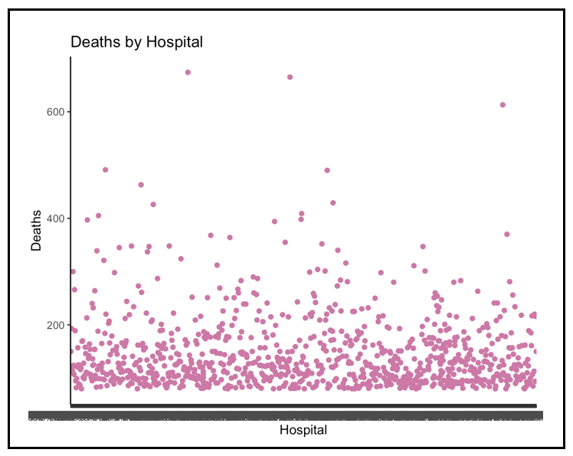
By Hospital
Write a function
Apply to each of our 12 data subsets

Slide 9
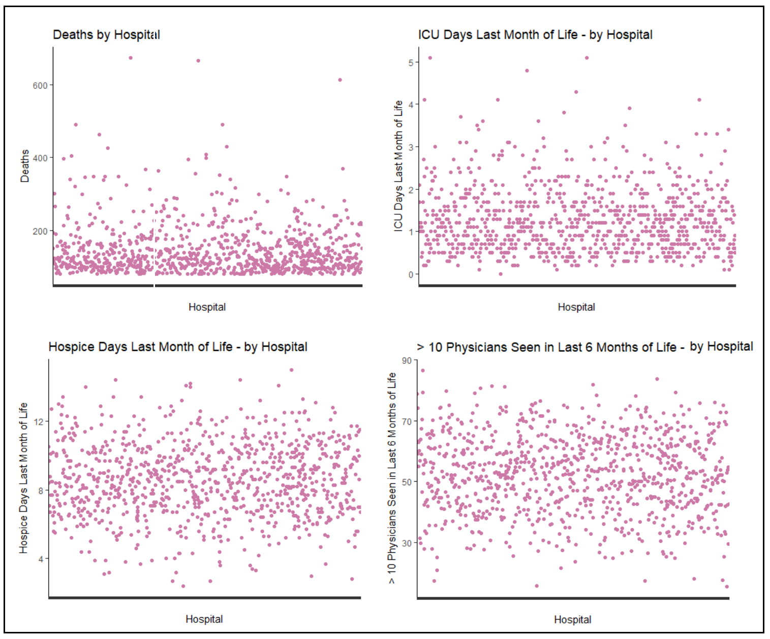
By Hospital
Trends/Insights (using the same variables shown for histograms)
This data shows similar information as before, but the spread is shown along the y axis
The bottom two charts again look more normally distributed.

Slide 10
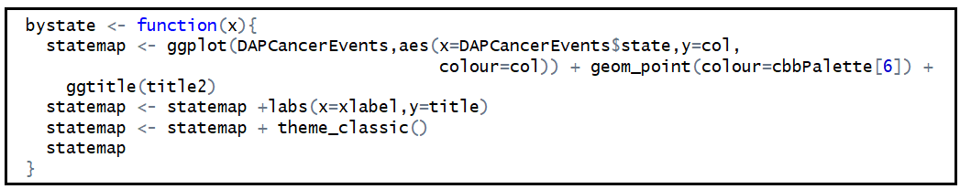
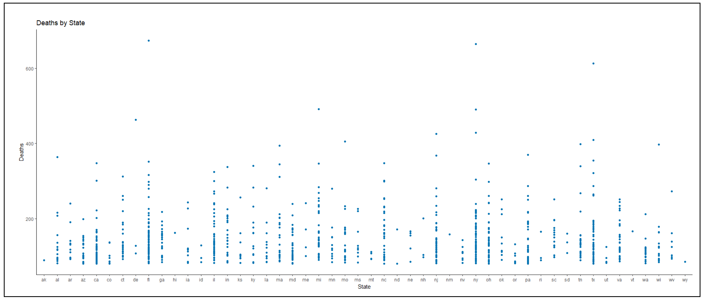
By State
Write a function
Apply to each of our 12 data subsets

Slide 11
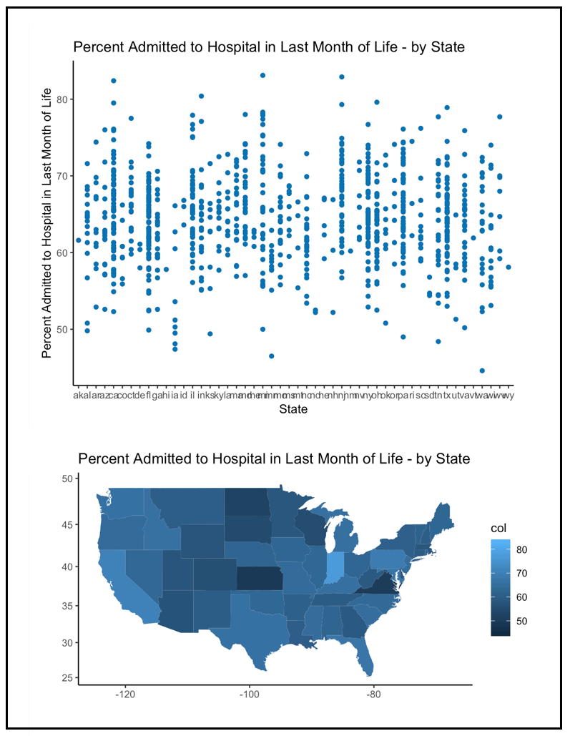
By State
Trends/Insights:
I think we learned that using
geom_map to map the data out
was a more effective way to
visualize this data.

Slide 12
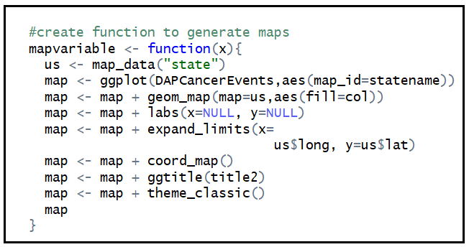
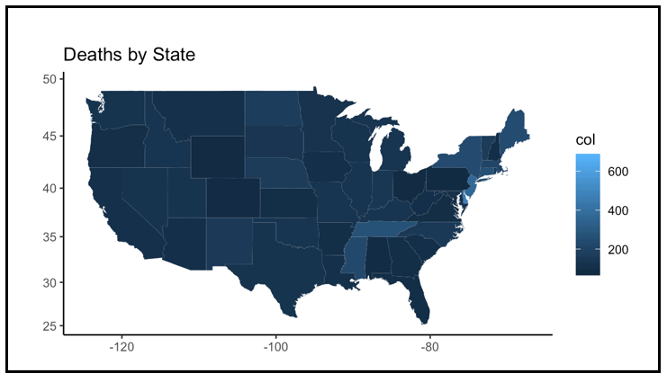
Visualize on US Map
Write a function
Apply to each of our 12 data subsets

Slide 13
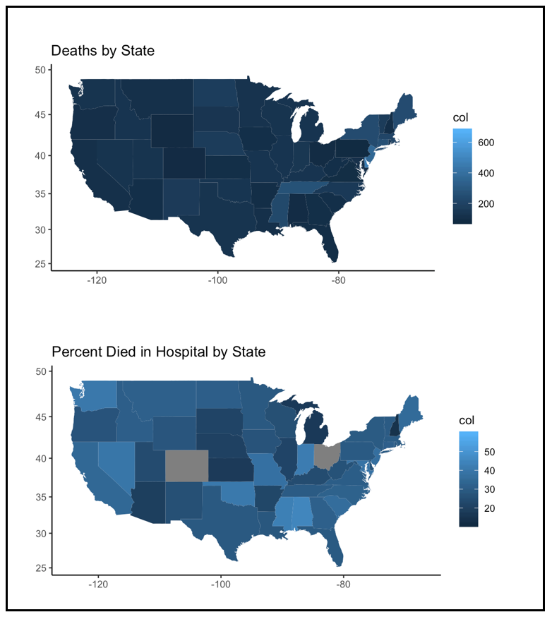
Visualize on US Map
Trends/Insights:
Number of Deaths by State
did not show much variation
contrasted with
Percent Died in Hospital by State
(some data is missing)

Slide 14
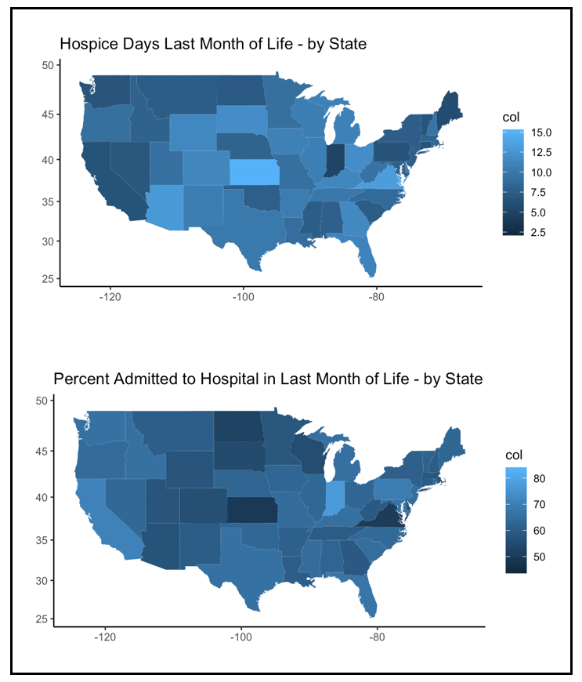
Visualize on US Map
Trends/Insights
Hospice Days Last Month of Life &
Percent Admitted to Hospital Last Month
Both showed variation,
but it appears to be inverse.
This makes sense, given the
correlation of -0.67.
(more on correlation next)

Slide 15
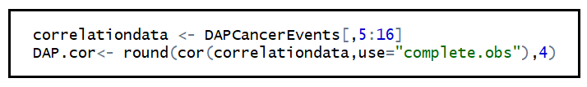
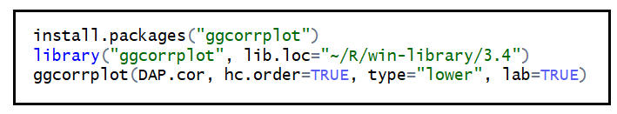
Correlation
Run a correlation on 12 variables (columns 5-16)
Visualize using ggcorrplot package (visual on next slide)
Strongest Positive Correlations:
% admitted ICU last month & ICU days last month = 0.93
% hospice last month & hospice days last month = 0.80
Strongest Negative Correlations:
% hospice last month & % died in hospital = -0.88
hospice days last month & % died in hospital = -0.71

Slide 16
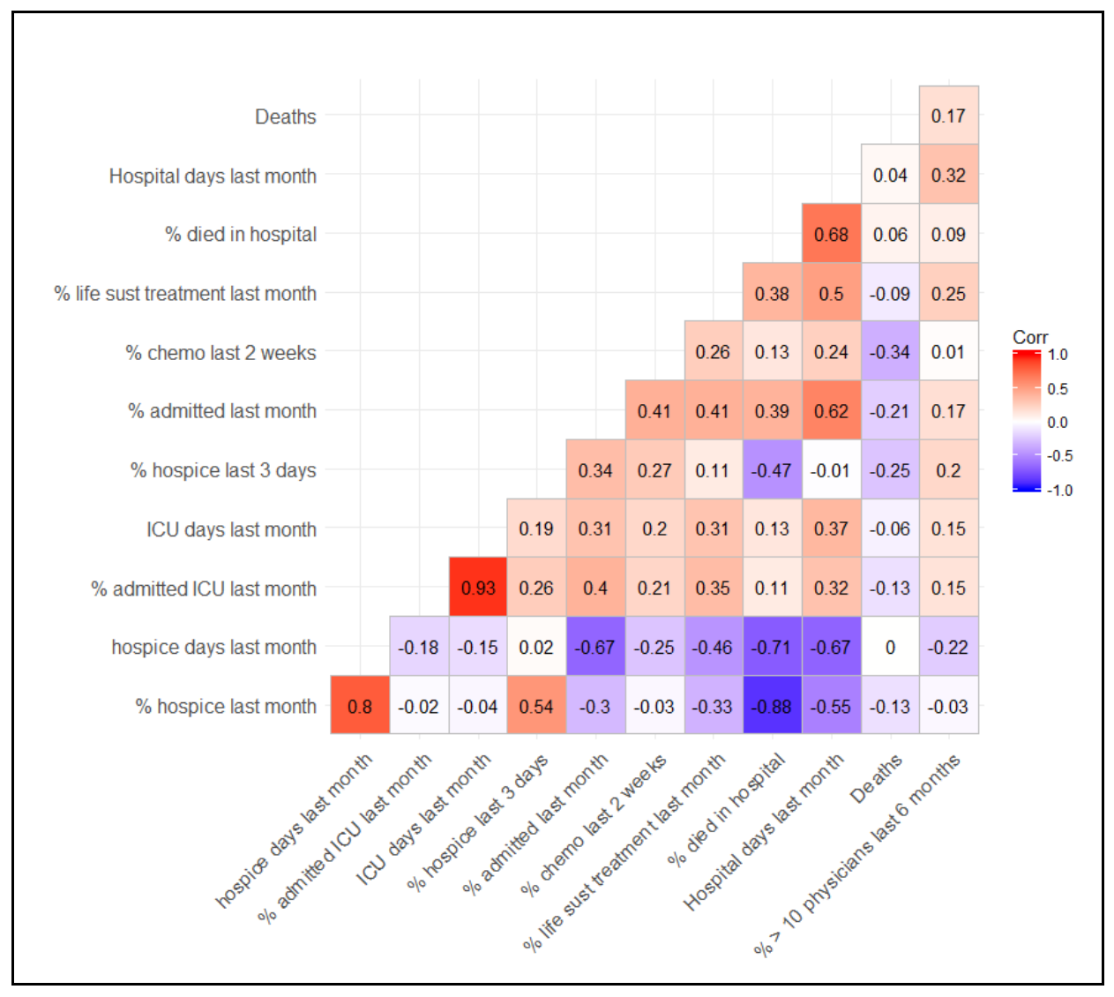
Correlation

Slide 17
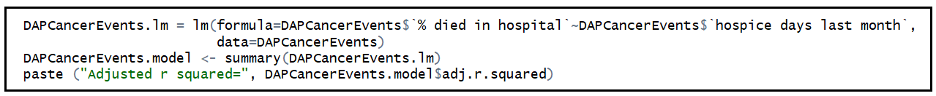
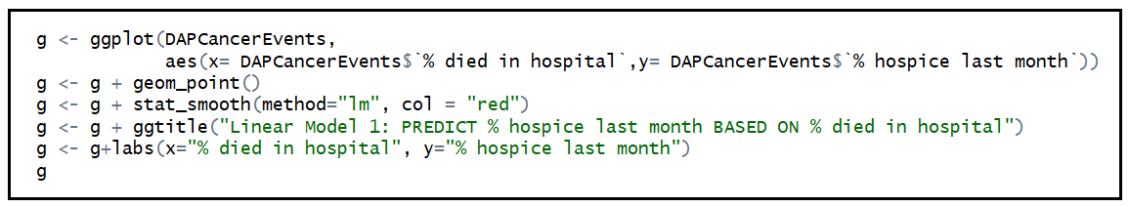
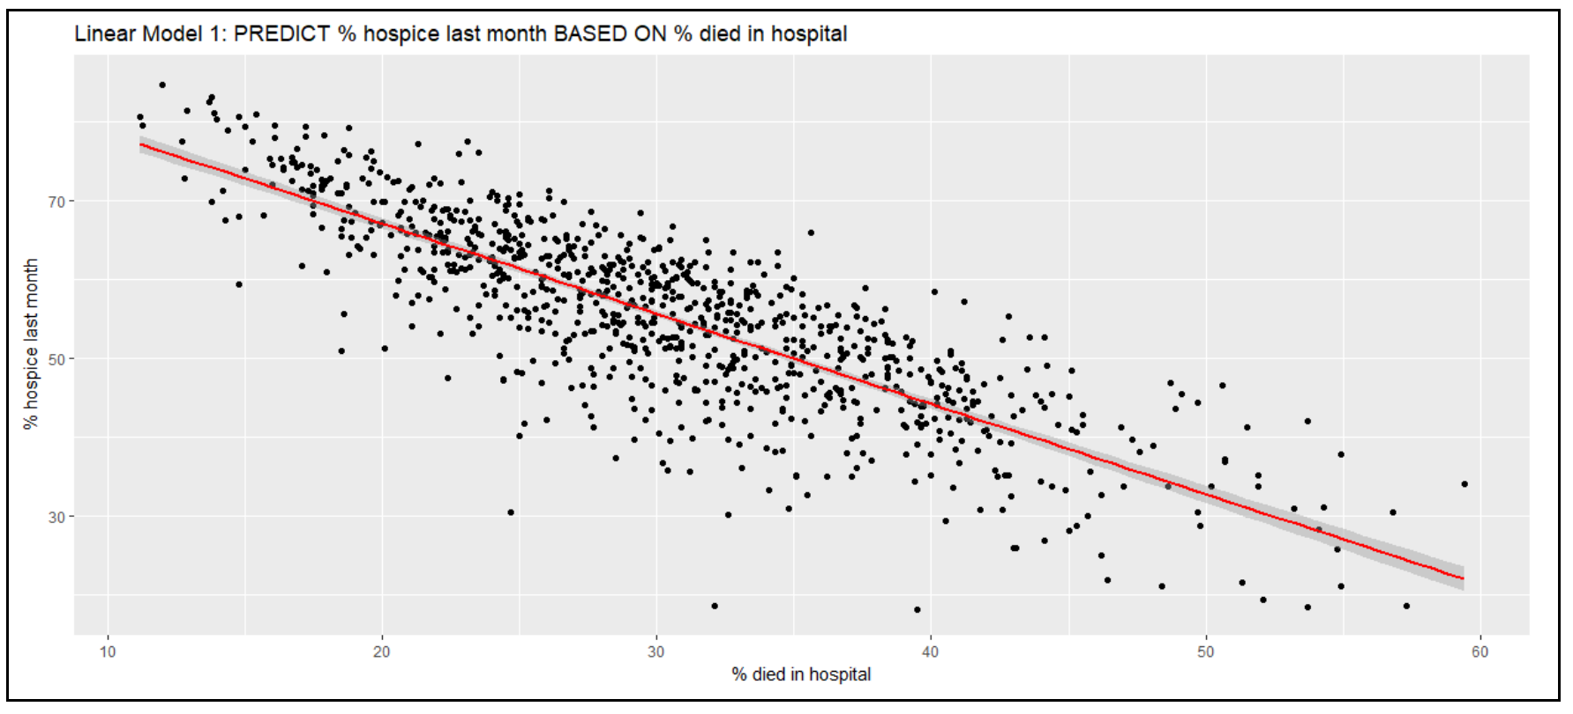
Linear Regression
Wrote code for linear regression models
Wrote code for visualizing models

Slide 18
Linear Regression
Run linear regression for all models with correlation stronger than 0.5 or -0.5
All P-values were significant
Adjusted R Squared ranged from 0.27 to 0.83
Run linear regression on a model with multiple predictors
All P-values were significant
Adjusted R-Squared was 0.76
Run linear regression on % died in hospital per state, then by city, then by both city & state
Most p-values were not significant
Including city & state gave the strongest Adjusted R-squared (0.51)

Slide 19
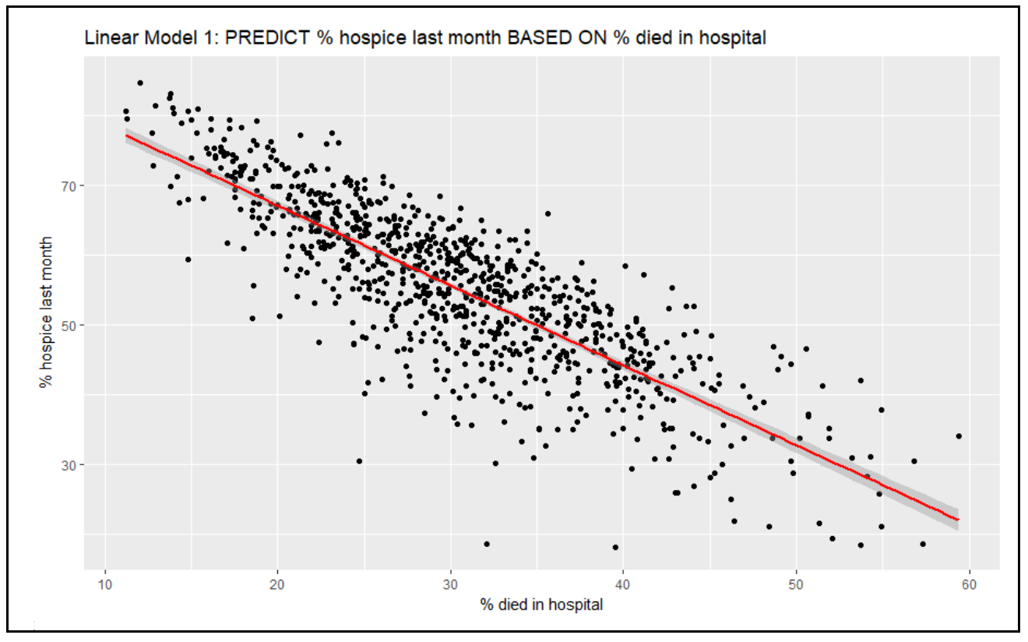
Linear Regression
Model of strongest negative correlation:
Correlation was -0.88
Adjusted R squared = 0.67

Slide 20
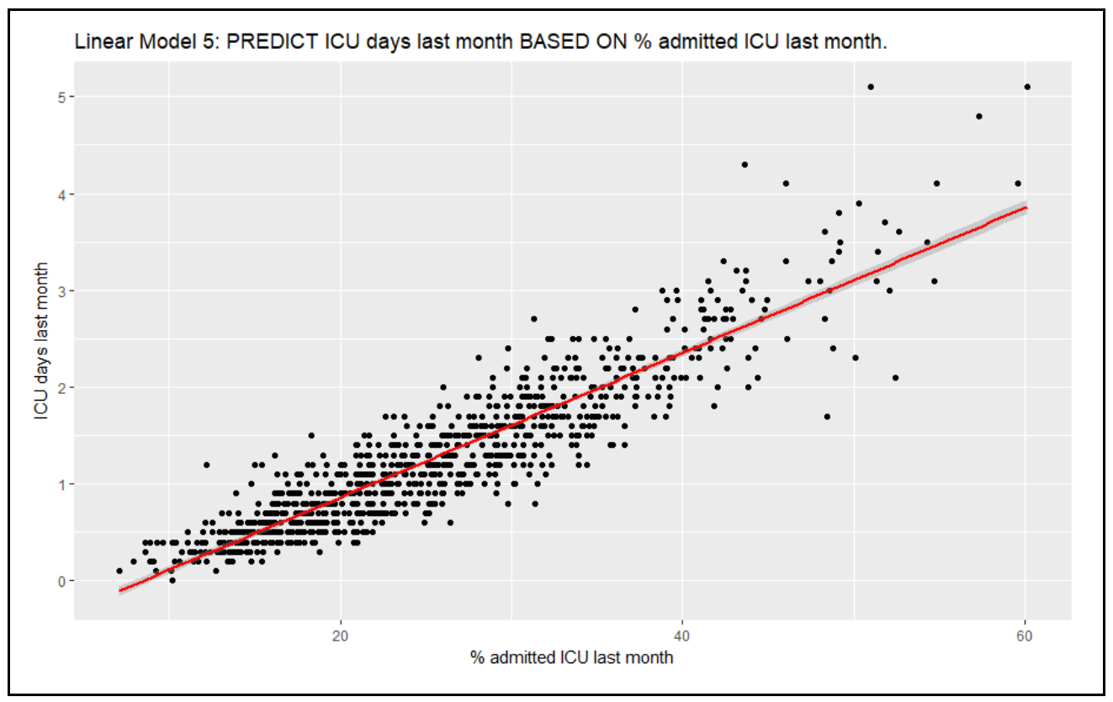
Linear Regression
Model of strongest negative correlation:
Correlation was 0.93
Adjusted R squared = 0.83

Slide 21
Conclusion
More is not always better
EX: if we see our correlation chart, death is more negatively correlated with percentage of chemo last 2 weeks of life than percentage of hospice last month, what that means is even thou both of them are negatively correlated with death, its better to be in hospice care than in an aggressive treatment like chemo in the last weeks of life.
For Dying Cancer Patients, Geography is sometimes Destiny
When we look at the end of life cancer care across geography and Hospitals, there are significant variations for different attributes
EX: Hospice days last month of life is more in Kansas, Virginia & Arizona on the other hand Hospital days last month of life is high in Oklahoma, Pennsylvania & Indiana. Also, If we take a look at percentage of life sustaining treatment last month of life, it is higher in eastern part of the country than western part of the country. Professionals may have to find out the why. So where you live and which hospital you go as a cancer patient decides what kind of care you will be getting.
Cancer is personal, so is the care patients need
If we take a look at percentage of chemo last 2 weeks of life through geography and from hospital to hospital, its different because cancer is personal and the care patients need is different. Ex. Chemo might work well for one patient and not for another.
Also if we take a look at Hospice days and Hospital days last month of life, they are different across geography why? Because Cancer is personal and so is the care you need. Some patients might prefer hospice over Hospital and some might choose Hospital over hospice.
Aggressive Care for Dying Cancer Patients at end of life is hard and so its better to focus on keeping patients comfortable
The data we are looking is poor prognosis cancer data, which means death is inevitable. If we again take a look at chemo in the last 2 weeks of life its negatively correlated with death, same is true for percentage of life sustaining treatment in last month of life. Since death is inevitable these aggressive treatments should be reduced and the focus might have to be on keeping patients comfortable

Slide 22
Reflections
A couple of the columns in the data set were very sparse, and that was a bit disappointing. The maps for those columns had a lot of missing states.
It was challenging to work with so many variables (12) that had such similar names (hospice sounds and looks a lot like hospital). It was easy to get things shifted/swapped, so we had to carefully double check our work.
Initially, our descriptive statistics looked off, but we were able to solve it by utilizing the Numberize function.
The Correlation didn’t work well at first (there were a lot of N/As). This was resolved by replacing the code use=“everything” with use=“complete.obs”
The correlation data was difficult to read, but we discovered the ggcorrplot package and it was an easy fix.

